Slide 1
All-Spark 50D50U-843
Universal Intermittent Pilot / Direct Spark Ignition Module

Slide 2
Business and Product Overview

Slide 3
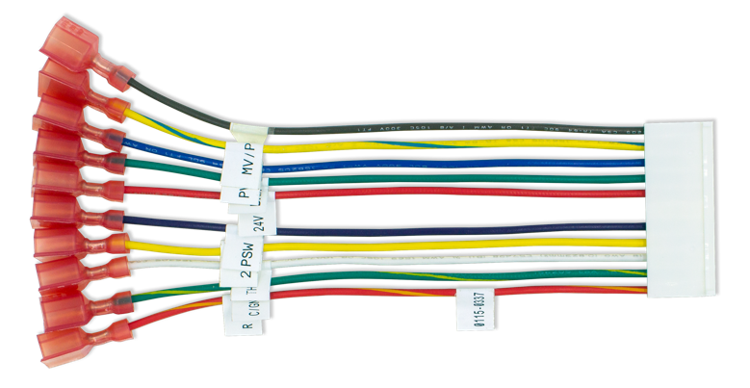

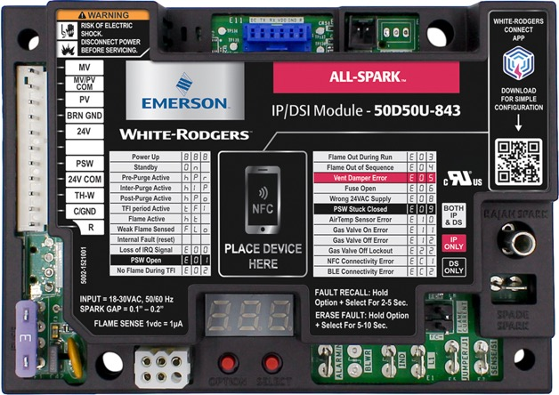
White-Rodgers All-Spark Ignition Module
The 50D50U-843 is the first universal replacement for 24V intermittent pilot or direct spark ignition that utilizes a mobile app for configuration and diagnostics.
  Replaces over 600 IP and 200 DSI part numbers.
Various configuration and mounting options.
Configurable on the control OR via Near Field Communication (NFC) and the White-Rodgers Connect app.

Slide 4

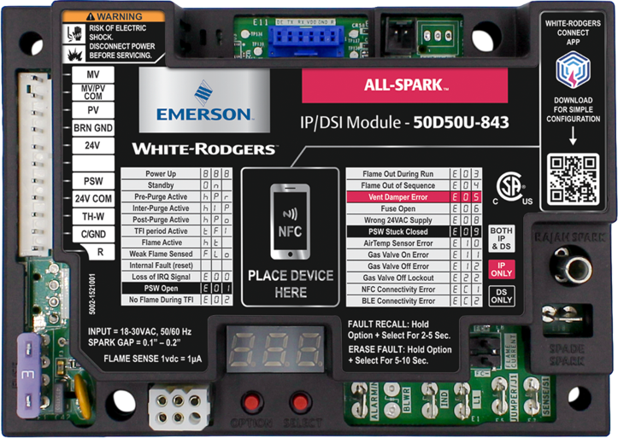
All-Spark Ignition Module
Control Features
11-pin In-line Connector
Pressure Switch Connection
Near Field Communication (NFC)
Optional Rajah spark plug or ¼” Spade
Serviceable Fuse
Flame Sense Test Pins
Vent Damper Connector
Alarm Output Connection
Local / Remote Flame Sense Connections​
3 Digit
7-Segment LED Display
Inducer Connection

Slide 5


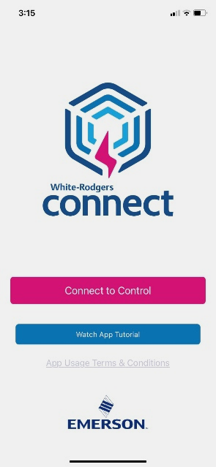
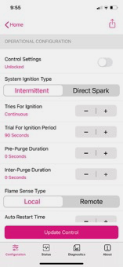
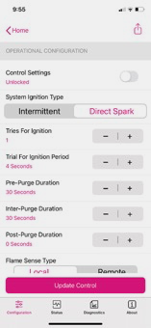
Introducing White-Rodgers Connect
Allows for on-phone configuration
No login or username required
Fully customizable app programming, module configurations
Shows status, diagnostics, and details about the module
Near Field Communication (NFC) creates an interface between the control and your mobile device with the White-Rodgers Connect app. Just place your mobile device on the control to enable a connection.
Once downloaded, the White-Rodgers Connect app does not require cellular/Wi-Fi service to use.

Slide 6
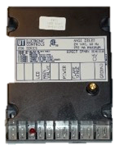
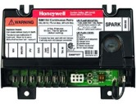
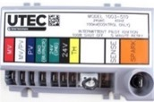
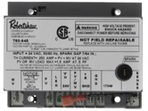
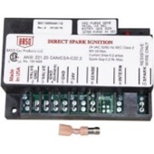
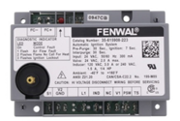
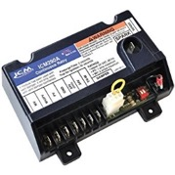
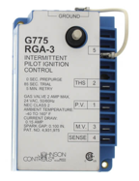
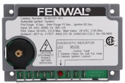
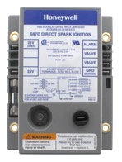
All-Spark Ignition Module Applications
Intermittent Pilot
(IP or Proven Pilot)
Direct Spark (DSI)
Systems with gas valves that have both a pilot valve & a main valve use these brands
Systems with gas valves that have only a main valve use these brands
Honeywell
S8610U
UTEC
1003
Robertshaw
780
BASO
C107U
UTEC
1016
Fenwal
35-60/61
ICM
290A
Johnson
G60/65/67/77
Fenwal
35-63
Honeywell
S87

Slide 7
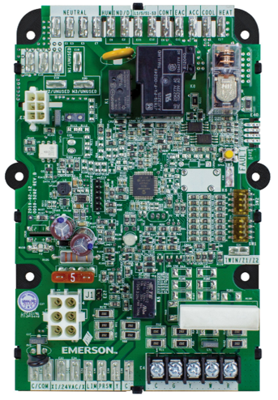
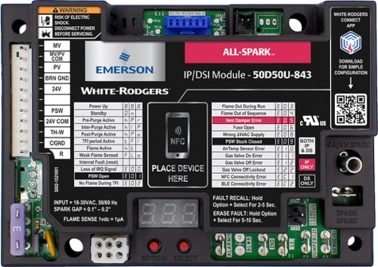
Non-Integrated Furnace Application
What is “Non-Integrated”?
A Non-Integrated Control is a partial control that connects to another for complete operation. For Forced Air Units, the 50D50U-843 will Integrate with a 50F06-843 Fan Timer module for complete Furnace operation.
  Most common All-Spark Ignition Module Furnace application!
  All-Spark can be installed in a wide range of applications, take a look at the next slide for more
PLUS +

Slide 8
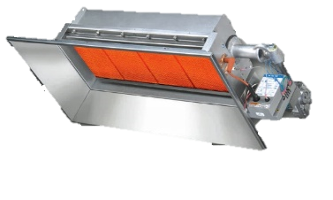
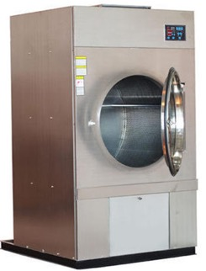
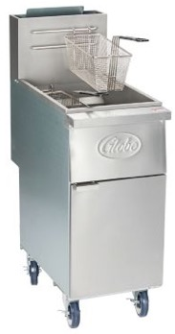
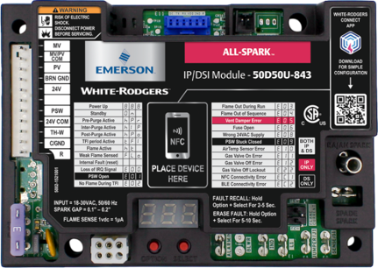
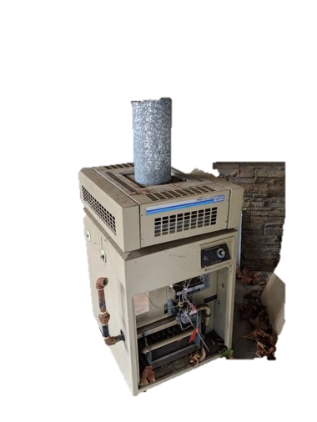
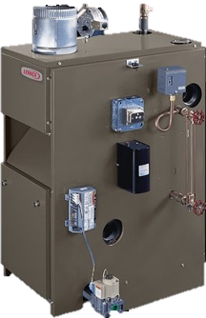
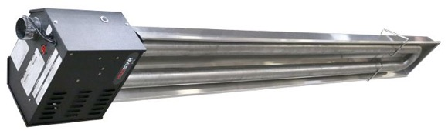
Additional Applications
Stand-alone Applications– All-Spark Ignition Module can also function as a stand-alone control where no blower is utilized.
Infrared Heater
Gas Dryer
Food Fryer
Gas Boiler
Pool Heater
Tube Heater
These stand-alone applications are still being manufactured every day!

Slide 9

Cross References
All-Spark Ignition Module has 800+ Cross References
600+ Intermittent Pilot Controls and 200+ Direct Spark Ignition Controls
Annual market is estimated to be over 500K replacements

Slide 10



All-Spark Ignition Module Benefits
2 Applications in 1
Easy Connections
Mobile Configuration
Combines Intermittent Pilot & Direct Spark Ignition in one control.
Full featured connections:
  On-board Vent Damper
  Alarm Output
  Inducer & Pressure Switch Inputs
With Rajah & ¼” Spade, the All-Spark Ignition Module connects to the majority of spark wiring.
24v 11-pin harness has all configuration wires that are made active through personalized configuration.
Utilizes Near Field Communication for simple system configuration

Slide 11
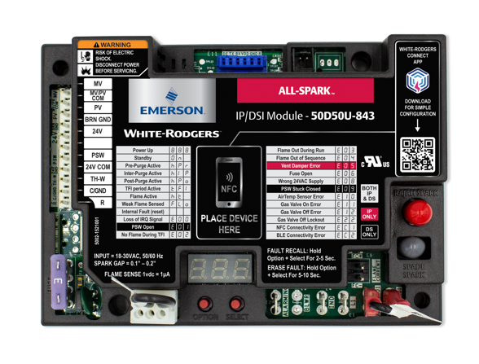
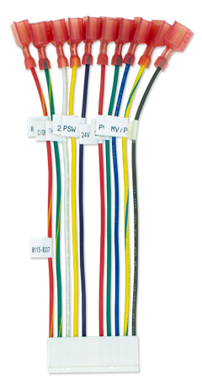

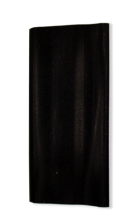

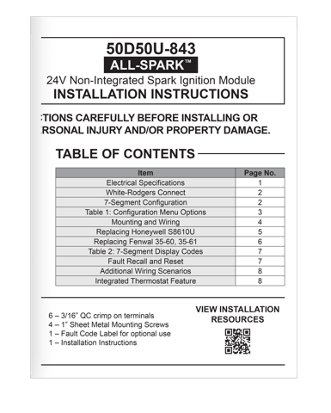
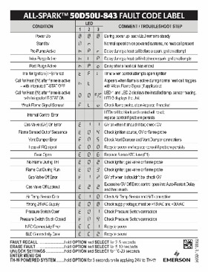
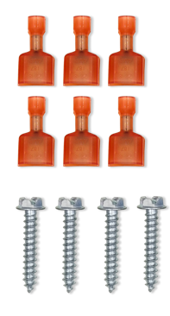
What’s in the Box
50D50U-843 Module
11-pin 24v Harness
Vent Damper Plug
Flame Sense Jumper
14-16 AWG ¼” Female QC Spade - Nail/Spike Spark Adapter with Shrink-wrap Sleeve
6 - 3/16” Male QC Spade Terminals
4 - 1” Mounting Screws
Fault Code Label
Instruction Sheet with QR Code link to Install Video
QR Code for White-Rodgers Connect app

Slide 12

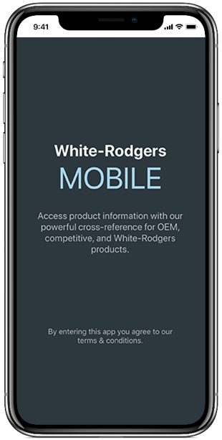


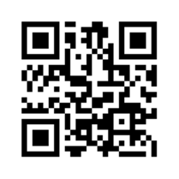
WR Mobile App
Always up-to-date and easy to use:
Mobile app
White-Rodgers Website
Your resource for:
Product information and spec sheets
Complete Cross Reference
OEM compatibility
Installation information and videos
Wiring diagrams
Download:
Go to your app store
Type in WR Mobile
Install the app
OR
Open your camera
Hold it over the QR code
Tap “Open” on the
pop-down
Install the app

Slide 13
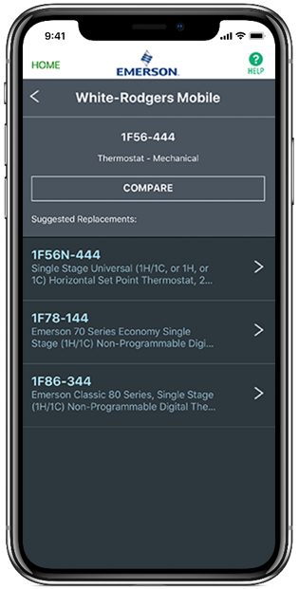
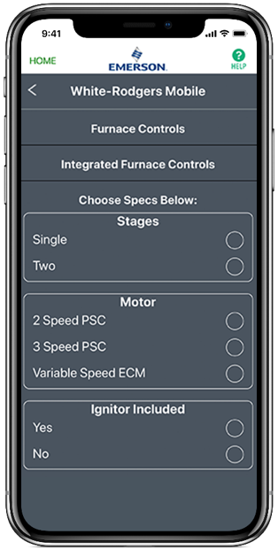
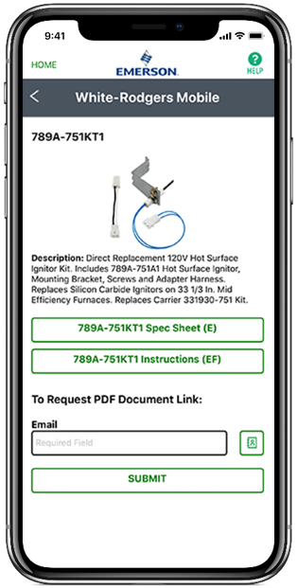
WR Mobile App
Easy to use!
Search by OEM, Competitive, or White-Rodgers Model Number
Product Number
Scrollable Product List
WR Replacement

Slide 14

White-Rodgers Cross Reference
Go to: www.whiterodgers.com
Hover over Tools & Resources
Click on: White-Rodgers Cross Reference/Product Information
Enter the Model Number or click on: Search Replacement Heating Controls by Major OEM Brand

Slide 15


Wholesale Resource Site
Access useful resources to grow your business.
Visit: https://climate.emerson.com/en-us/brands/white-rodgers/white-rodgers-wholesaler-resource-center
You’ll find videos, stocking lists and product launch information for the following product families:
Heating Controls
Cooling Controls
Sensi Smart™ Thermostats
Traditional Thermostats
Contractor Rewards
Product Merchandising

Slide 16

Why Contractors Trust White-Rodgers
Industry Leading Products
Used by more OEM’s
Offering widest range of Direct OEM and Universal Replacement Controls
Ease of Installation
Simple, easy to understand instructions
Product Reliability
Quality Control assures reliable products
Affordable
Competitive pricing
Supported by Knowledgeable Representatives
Contractor direct phone support

Slide 17
Technical

Slide 18
White-Rodgers All-Spark Ignition Module
The 50D50U-843 is the first universal replacement for 24V intermittent pilot or direct spark ignition that utilizes a mobile app for configuration and diagnostics.
  Replaces over 600 IP and 200 DSI part numbers.
Various configuration and mounting options.
Configurable on the control OR via Near Field Communication (NFC) and the White-Rodgers Connect app.

Slide 19

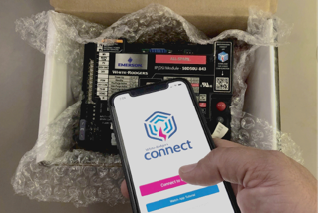
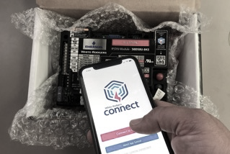
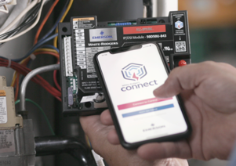
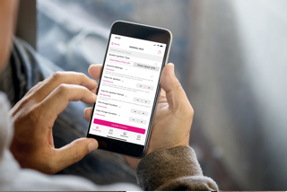





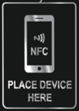
Understanding Near Field Communication
Powering
Connecting
Configuring
Updating
Configuration settings can be uploaded to the All-Spark Ignition Module prior to powering up the control.
NFC does not require a cellular connection, simply hold the mobile device on the NFC icon until a check mark appears.
Once the control is read, you may move your phone away to configure in the app.
After configuring, tap the “Update Control” button and hold the device on the NFC icon. Make sure to wait for a checkmark, to secure settings!

Slide 20

All-Spark Ignition Module Components
24v Components:
11-pin In-line Wiring Connector
Low Voltage Fuse
Vent Damper Plug
Alarm Output Spade
Bluetooth Connector*
Remote Temperature** Connector
5
6
1
120v Components:
2
Line 120v Input Spade
120v Inducer Output Spade
8
7
3
4
7
6
* Planned for release in 2022/2023
** Coming by Jan 2022

Slide 21
All-Spark Components
Other Components:
Flame Sense Jump Spade
Flame Sense Spade
Honeywell (S8600)
or Fenwal (35-60) Mounting options
Rajah or ¼” Spade Connectors
Flame Sense Test Pins
Near Field Communication Connect Area
3 - Seven Segment Status / Fault LEDs
Options/Select Buttons
3
3
6
4
7
5
3
3
8
1
2

Slide 22

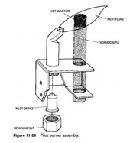
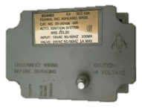
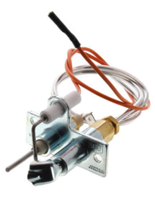
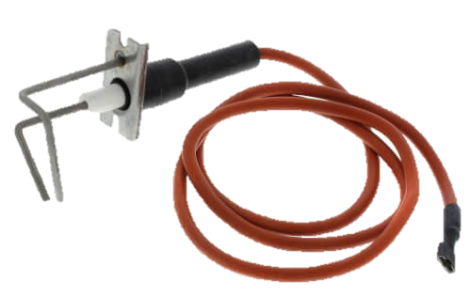
Spark Ignition in Residential Furnace Applications
Shorten copy, possible 2 slides. Emily to update once copy is shortened.
The National Appliance Energy Conservation Act set a minimum of 78% Annual Fuel Utilization Efficiency (AFUE)
Most* manufactures have switched from Spark ignition, Silicon Carbide, & 80v Nitride to 120v Nitride
Emerson Electric Co. invents & patents the concept of Direct Spark Ignition at burners, eliminating the need for a pilot
An Intermittent Spark Ignition system is introduced to replace Standing Pilot Systems
Dante Raso of Brooklyn, NY invents the standing pilot light system
Manufactures stop building furnaces with standing pilot light ignition systems
* Exception: Rheem still uses Direct Spark Ign.
1928
1968
1987
1984
2006
Era of Forced Air Furnace Spark Ignition Systems
Spark Ignition is the primary option for natural gas & propane furnaces.
It requires a rapid release of high electrical voltage from an electrical coil.
  Electric is transferred through an insulated wire to a metal rod placed close to a grounded object.
  The electricity jumps the gap to create an electrical arc.
  Gas is released over this arc and is ignited.
Many other applications using spark ignition are still being manufactured today
Pilot Ignitor
Direct Spark Ignitor
Notes:
Silicon Carbide was used from 1987 to 2006, making a 19 year run in manufacturing.
80v Silicon Nitride had a shorter run of 9 years.
120v Silicon Nitride has been used in manufacturing for the last 13 years.

Slide 23
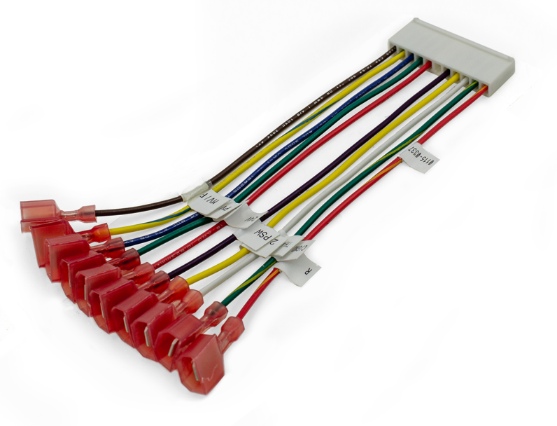
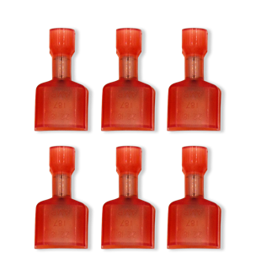
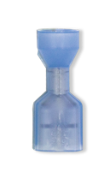
24v 11-Pin Harness
By providing a harness with ¼” spade connectors, all the wiring can be removed one at a time from the existing control and matched up with the harness labels prior to removing the existing control.
For some applications six 3/16” spade connectors are provided.
11-pin Harness Assembly
6 - 3/16” Male QC Spade Terminals
14-16 AWG ¼” Female QC Spade

Slide 24
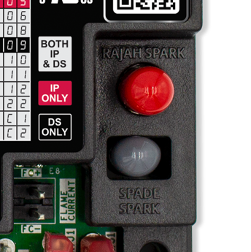
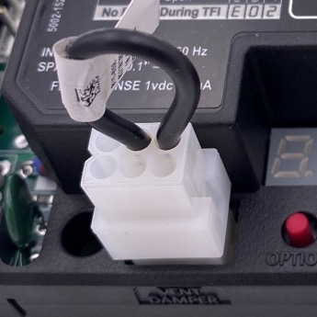

All-Spark Ignition Module Features
Vent Damper with Jumper Plug
Spark Terminal Options
The vent damper connector is now built in and allows for easy connection to systems that utilize this feature.
Both rajah & ¼” spade terminals are built-in.
A ¼” spade to spike/nail adapter with shrink sleeve is also included.
Terminals come capped. Remove only the cap being used.
Once attached,
an internal fuse in All-Spark allowing operation opens.

Slide 25






Flame Sense Jumper Feature
Local vs Remote Sense
Flame sense can be configured to sense the flame through the “Local” spark rod or “Remote” through a separate flame sensor.
A Local Configuration refers to using a single rod by combining both spark and flame sense in one wire
A Remote Configuration refers to using 2 separate rods for the spark and flame sense circuits to operate independently
or
+
Use Jumper
Use Sense/S1 Spade

Slide 26



Utilizing the Flame Test Pin Feature
2 pins extend from the control board to the surface of the cover.
To Test:
The furnace must have a call for heat and the burners producing flame.
Set a multimeter to vDC and place a meter probe on each pin.
Convert vDc to MicroAmps using a 1:1 ratio.
A good flame sense reading will be between 1.0 – 5.0 μA.
Test Pins

Slide 27



Intermittent Pilot - TH-W Wire Applications
Some older IP Modules did not connect to TH-W.
If the module only connects to 24v & 24v ground, when installing All-Spark Ignition Module connect the wire that was going to 24v to the TH-W wire on the 11-pin harness.
The 50D50U-843 will power up each time there is a call for heat. No configuration settings are lost.
If 3 wires – connect all 3
If 2 wires – connect 24v(Gnd) & TH-W
All-Spark does not need to be constantly powered

Slide 28



DSI - Inducer & Pressure Switch Options
Direct Spark Only
When the module is set to Direct Spark Ignition, an option to power an inducer and monitor the system pressure switch is available.
The module will not allow for system ignition until a signal is present on the pressure switch circuit indicating that the switch has closed.
Pressure switch monitoring & 120v Inducer power is not available in IP applications

Slide 29

Optional Feature - Alarm Output Terminal
For applications using an alarm, the ¼” Spade labeled ALARM can be connected to the system.
The alarm circuit has a normally open relay and when initiated will close and supply the alarm spade with 24 volts.
All-Spark can monitor system operation & send out a signal in the event of a lockout condition.

Slide 30




Additional New Features
Bluetooth Capability
A plug-in module is planned for release in 2022/2023
Integrated Thermostat Feature
By connecting a F67-8535 temperature sensor, the 50D50U-843 will be able to function as its own thermostat and maintain a temperature set on the 7-segment display.
  Coming by January 2022
White-Rodgers
F67-8535 Temperature Sensor

Slide 31


Easy to Install Mounting Options
Matching Modules Being Replaced
4 mounting holes are designed to match the board being replaced and give multiple options for alternate mounting.
4 – ¼” x 1 Mounting screws are provided.
White-Rodgers matches mounting holes with competitors' modules.

Slide 32


50M56U-843 Competitive Comparison
FEATURE | Fenwal 35-60, -61 | Honeywell S8610U | W-R All-Spark 50D50U-843
Cross Ref. #s | 1 (individual SKUs) | 425 | 800+
Ignition Type | DSI | IP | Both in 1
User Configuration |  | Dipswitch | White-Rodgers Connect App or Digital LEDs
Inducer/PSW
Alarm Output
On-board Spark Output | Rajah or Spade | Spade | Rajah and Spade
Flame Current | Test Pins | LED Flash + Test Pins | Test Pins
NFC + App
Integrated Thermostat* |  |  | * Available Dec 2021

Slide 33
Why Contractors Trust White-Rodgers
Industry Leading Products
Used by more OEM’s
Offering the widest range of Universal Replacement Controls
Ease of Installation
Simple, easy to understand instructions
Product Reliability
Quality Control assures reliable products
Affordable
Competitive pricing
Supported by Knowledgeable Representatives
Contractor direct phone support

Slide 34
Install

Slide 35
White-Rodgers All-Spark Ignition Module
The 50D50U-843 is the first universal replacement for 24V intermittent pilot or direct spark ignition that utilizes a mobile app for configuration and diagnostics.
  Replaces over 600 IP and 200 DSI part numbers.
Various configuration and mounting options.
Configurable on the control OR via Near Field Communication (NFC) and the White-Rodgers Connect app.

Slide 36
What’s in the Box
50D50U-843 Module
11-pin 24v Harness
Vent Damper Plug
Flame Sense Jumper
14-16 AWG ¼” Female QC Spade - Nail/Spike Spark Adapter with Shrink-wrap Sleeve
6 - 3/16” Male QC Spade Terminals
4 - 1” Mounting Screws
Fault Code Label
Instruction Sheet with QR Code link to Install Video
QR Code for White-Rodgers Connect app

Slide 37

Disconnect Power and Gas
1
First, ensure power and gas are disconnected prior to servicing the unit.

Slide 38

Verify Replacement
2
Check the part number on the existing control and verify it is one of the 800+ modules that can be replaced with the 50D50U-843. Use the cross-reference on the side of the carton or the White-Rodgers Mobile app.

Slide 39

Take a Picture
3
Take a picture of the existing module for reference before removing any wires.

Slide 40

Note Existing Wiring
4
Identify the existing wiring and take note of the terminal identifiers on the existing module.

Slide 41


Reference Installation Instructions
5
Remove the spark wire and locate the 11-pin harness assembly. The installation instructions come with a diagram showing wiring connections for both an Intermittent Pilot system and a Direct Spark system. For this application the Intermittent pilot diagram will be used.

Slide 42

Disconnect/Connect Wiring
6
Individually disconnect and transfer each wire from the existing control and connect it to the appropriate Quick Connect terminal on the 50D50U -843 11-pin harness or dedicated spade terminal on the Printed Circuit Board.

Slide 43


Remove Existing Module
7
Once all wires have been transferred, remove the existing module. Take note if there is a ground wire attached to one of the mounting screws.

Slide 44

Configure
8
The module can be configured by 2 different methods. On-board configuration can be done after the module has been installed and powered up. Mobile app configuration is the preferred method and can be done prior to installing the module.
To configure using the mobile app method, go to your mobile device’s app store, search for “White-Rodgers Connect”, and download.
Once downloaded, open the app. The home page has a ‘Connect to control” and “Watch tutorial video” button. Select the “connect to control” button. The screen will show “ready to scan”.

Slide 45

Configure on the App
9
  Place the mobile device in contact with the NFC logo on the module. A check mark will appear showing the connection was successful
  The app will then display the 50D50U-843 settings configuration screen. First choose whether the module being replaced is an intermittent pilot or a direct spark ignition system.
  Table 1 on page 3 of the installation instructions show configuration options.
  Included in the direct spark section is the configuration options when utilizing the Integrated Thermostat.

Slide 46





Fully Customizable App Programming
Intermittent Pilot Settings
Direct Spark Ignition Settings
Choosing a System Ignition Type “Intermittent” will display only IP options
Choosing a System Ignition Type “Direct Spark” will display only DSI options

Slide 47




Update Configuration Settings from the App
- setup your control faster!
Easy Update
After making configuration changes, tap update control. Hold steady until checkmark appears. This may take up to 10 seconds
Once the new configuration is uploaded, a confirmation will display
Once the control has cycled 10 times it will lock in the settings. To make changes afterwards, toggle the control settings switch to unlock to reconfigure
Update
Complete!
Unlock
It can take up to 10 seconds to update when holding your phone steady over the module.

Slide 48



Additional App Features
The app displays all the information shown on the 7-segment display and more!
Get what you need to know!
Status
  See what is going on with voltage, configuration, & operation
Diagnostics
  Look up current active errors as well as the last 5 errors occurring is the last 14 days
  View troubleshooting tips
About
  Get module specific information including the date code and the operating firmware
Status
Diagnostics
About
Only White-Rodgers gives you all this info on your smartphone!

Slide 49

Mount the All-Spark Ignition Module
10
  Mount the 50D50U-843 in the unit using the mounting holes and supplied screws. NOTE: For this application, there is a ground wire that needs to be reinstalled.

Slide 50

Vent Damper
11
For applications using a vent damper, remove the vent damper jumper plug and install the unit connector.
In applications using a remote flame sensor, remove the flame sense jumper and plug the flame sense wire into the SENSE terminal.
For this application no damper or remote flame sense is used.

Slide 51

Connect 11-Pin Harness
12
Plug the 11-pin harness into the module.

Slide 52

Attach Spark Wire
13
For this application the one quarter inch spade is used. Remove the lower gray cap and plug in the spark wire.

Slide 53

Fault Code Label
14
Apply fault code label to the unit for easy reference.

Slide 54

Reconnect Power and Gas
15
The system is now ready to be powered on. Reconnect the electric power and gas to the unit, and make sure the door switch is engaged.
If configuration was not completed using the White-Rodgers Connect Mobile app, it can now be set-up using the “option” and “select” buttons and the L E D Display. To enter configuration, press the “Option” button while the unit is in standby.

Slide 55



OR Configure on the Control
Using Option & Select Buttons
If system is powered through 24v, the display will read ON when in standby mode. To enter set-up, press the Option Button.
16
If no 24v is present due to wiring TH-W & 24v Com, hold the Option Button down when initiating a call for heat to enter set-up.
The 50D50U-843 is factory programmed to match the Intermittent Pilot S8610U Module

Slide 56



Troubleshooting
The 3 Digit 7-Segment LED Display gives an on-board real-time status.
Fault & Status codes can be identified by the table on the cover of the module or by the Fault Code Label attached to the unit at the time of installation.
To recall a fault, press the Option & Select Button together for 2-5 seconds

